Slide 1
Parallel and Distributed Computing
CS3006
Lecture 5
Parallel Algorithm Design Life Cycle
7th March 2022
Dr. Rana Asif Rehman

Slide 2
Agenda
A Quick Review
Parallel Algorithm Design Life Cycle
Tasks, Decomposition, and Task-dependency graphs
Granularity
Fine-grained
Coarse-grained
Concurrency
Max-degree of concurrency
Critical path length
Average-degree of concurrency
Task-interaction Diagrams
Processes and mapping

Slide 3
Quick Review to the Previous Lecture
Static vs Dynamic Interconnections
Network Topologies
Linear array
Star
Mesh
Tree
Fully-connected
Hypercube
Evaluating Static interconnections
Cost
Diameter
Bisection-width
Arc-connectivity

Slide 4
Principles of Parallel Algorithm Design

Slide 5
Principles of Parallel Algorithm Design
Steps in Parallel Algorithm Design
Identification: Identifying portions of the work that can be performed concurrently.
Work-units are also known as tasks
E.g., Initializing two mega-arrays are two tasks and can be performed in parallel
Mapping: The process of mapping concurrent pieces of the work or tasks onto multiple processes running in parallel.
Multiple processes can be physically mapped on a single processor.
Notes:
Process is logical agent for computation over a physical processing element(processor).

Slide 6
Principles of Parallel Algorithm Design
Steps in Parallel Algorithm Design
Data Partitioning: Distributing the input, output, and intermediate data associated with the program.
One way is to copy whole data at each processing node
Memory challenges for huge-size problems
Other way is to give fragments of data to each processing node
Communication overheads
Defining Access Protocol: Managing accesses to data shared by multiple processors (i.e., managing communication).
Synchronizing the processors at various stages of the parallel program execution.
Notes:
Array sum

Slide 7
Principles of Parallel Algorithm Design
Decomposition:
The process of dividing a computation into smaller parts, some or all of which may potentially be executed in parallel.
Tasks
Programmer-defined units of computation into which the main computation is subdivided by means of decomposition
Tasks can be of arbitrary size, but once defined, they are regarded as indivisible units of computation.
The tasks into which a problem is decomposed may not all be of the same size
Simultaneous execution of multiple tasks is the key to reducing the time required to solve the entire problem.
Notes:
Problem is divided into tasks (chunks), could be of same and different size
We could use task dependency graph to explain decomposition e.g. adding 8 numbers using 4 processors

Slide 8
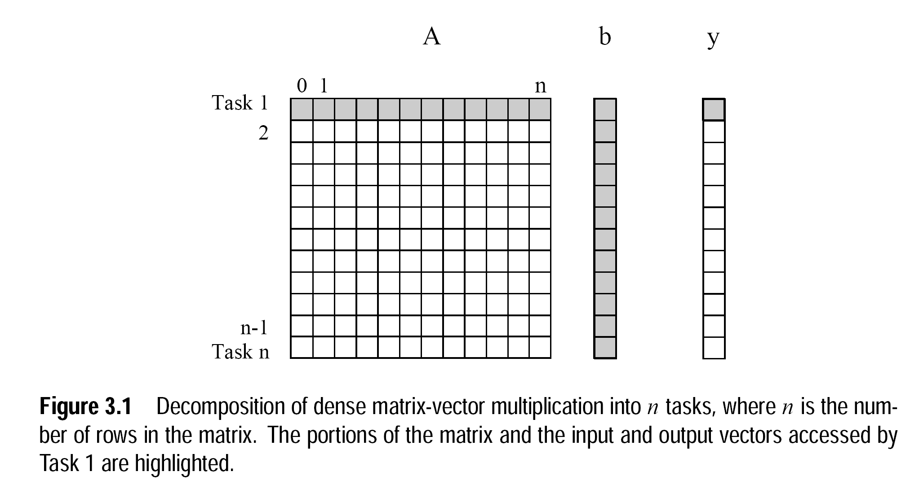
Notes:
Computation of each y[i] is regarded as a single task.
Matrix multiplication rule: no. of columns in first matrix A should be equal to no. of rows in second b
Resulting matrix would have the no. of rows equivalent of first matrix and no. of columns of second matrix

Slide 9
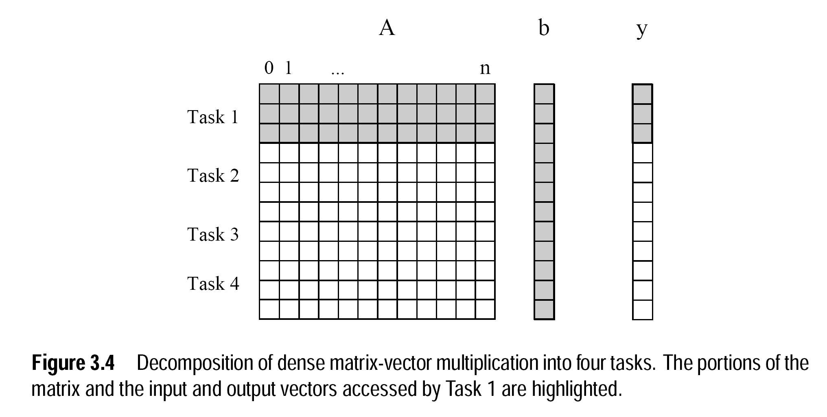
Notes:
Computation of three y[i] entries is regarded as a task

Slide 10
Principles of Parallel Algorithm Design
Task-Dependency Graph
The tasks in the previous examples are independent and can be performed in any sequence.
In most of the problems, there exist some sort of dependencies between the tasks.
An abstraction used to express such dependencies among tasks and their relative order of execution is known as a task-dependency graph
It is a directed acyclic graph in which node are tasks and the directed edges indicate the dependencies between them
The task corresponding to a node can be executed when all tasks connected to this node by incoming edges have completed.
Notes:
Some tasks may use data produced by other tasks and thus may need to wait for these tasks to finish execution

Slide 11
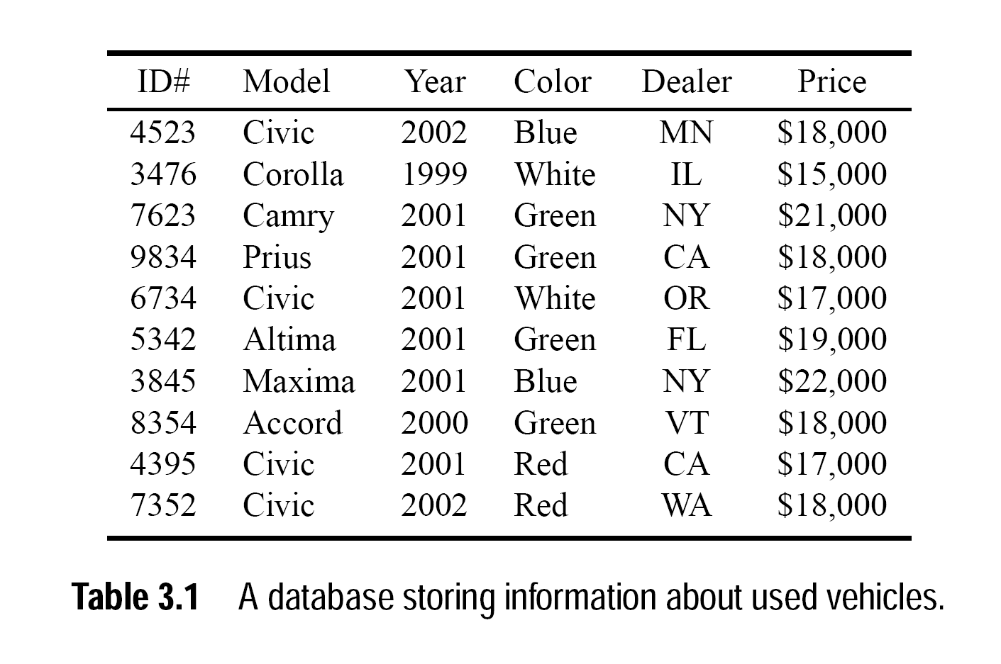
Notes:
Total records are 10.
Select ID, model, year, color from dbtable where model=‘civic’ and year=‘2001’ and (color=‘White’ OR color=‘Green’)

Slide 12
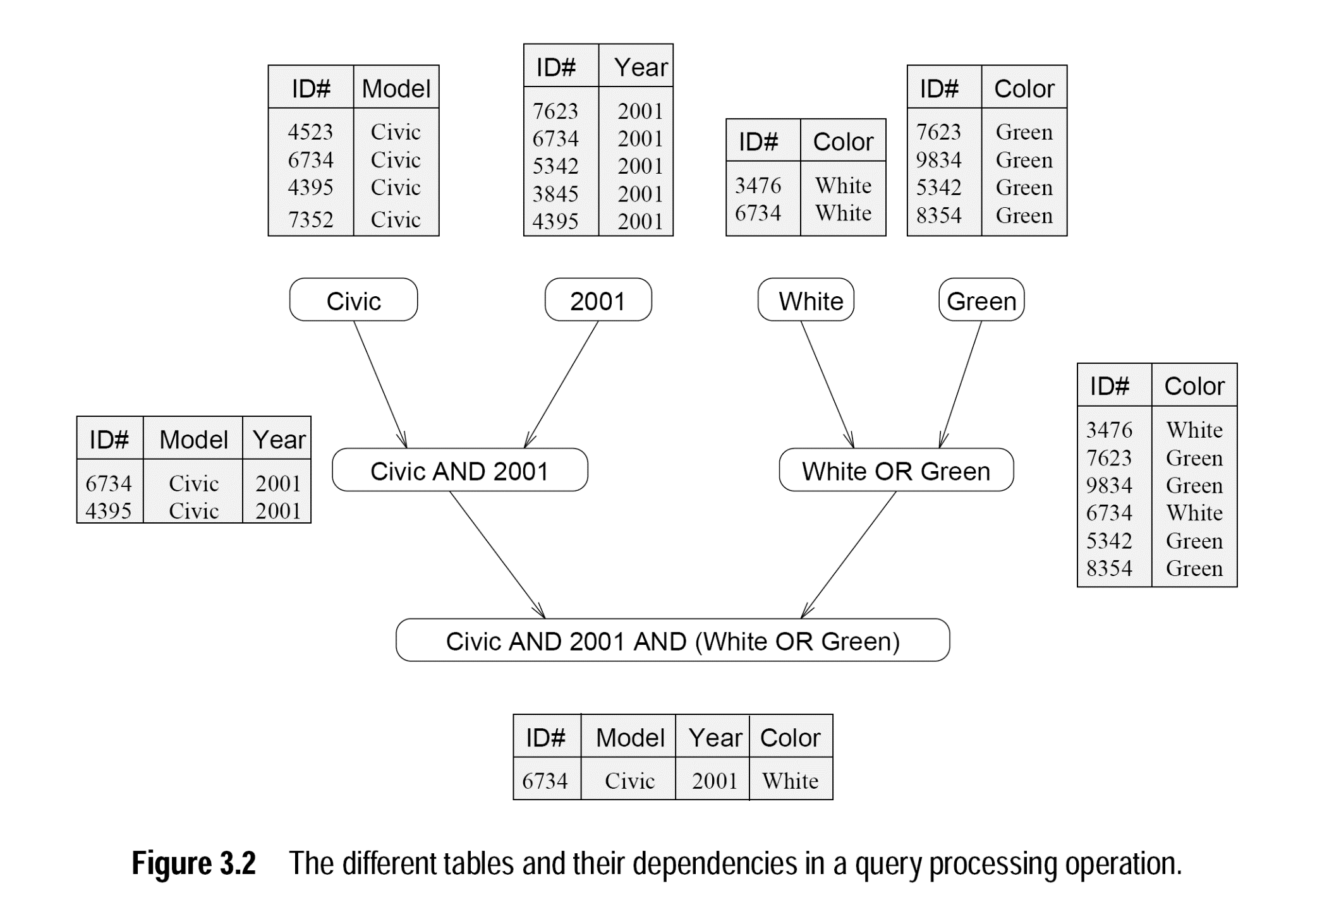

Slide 13
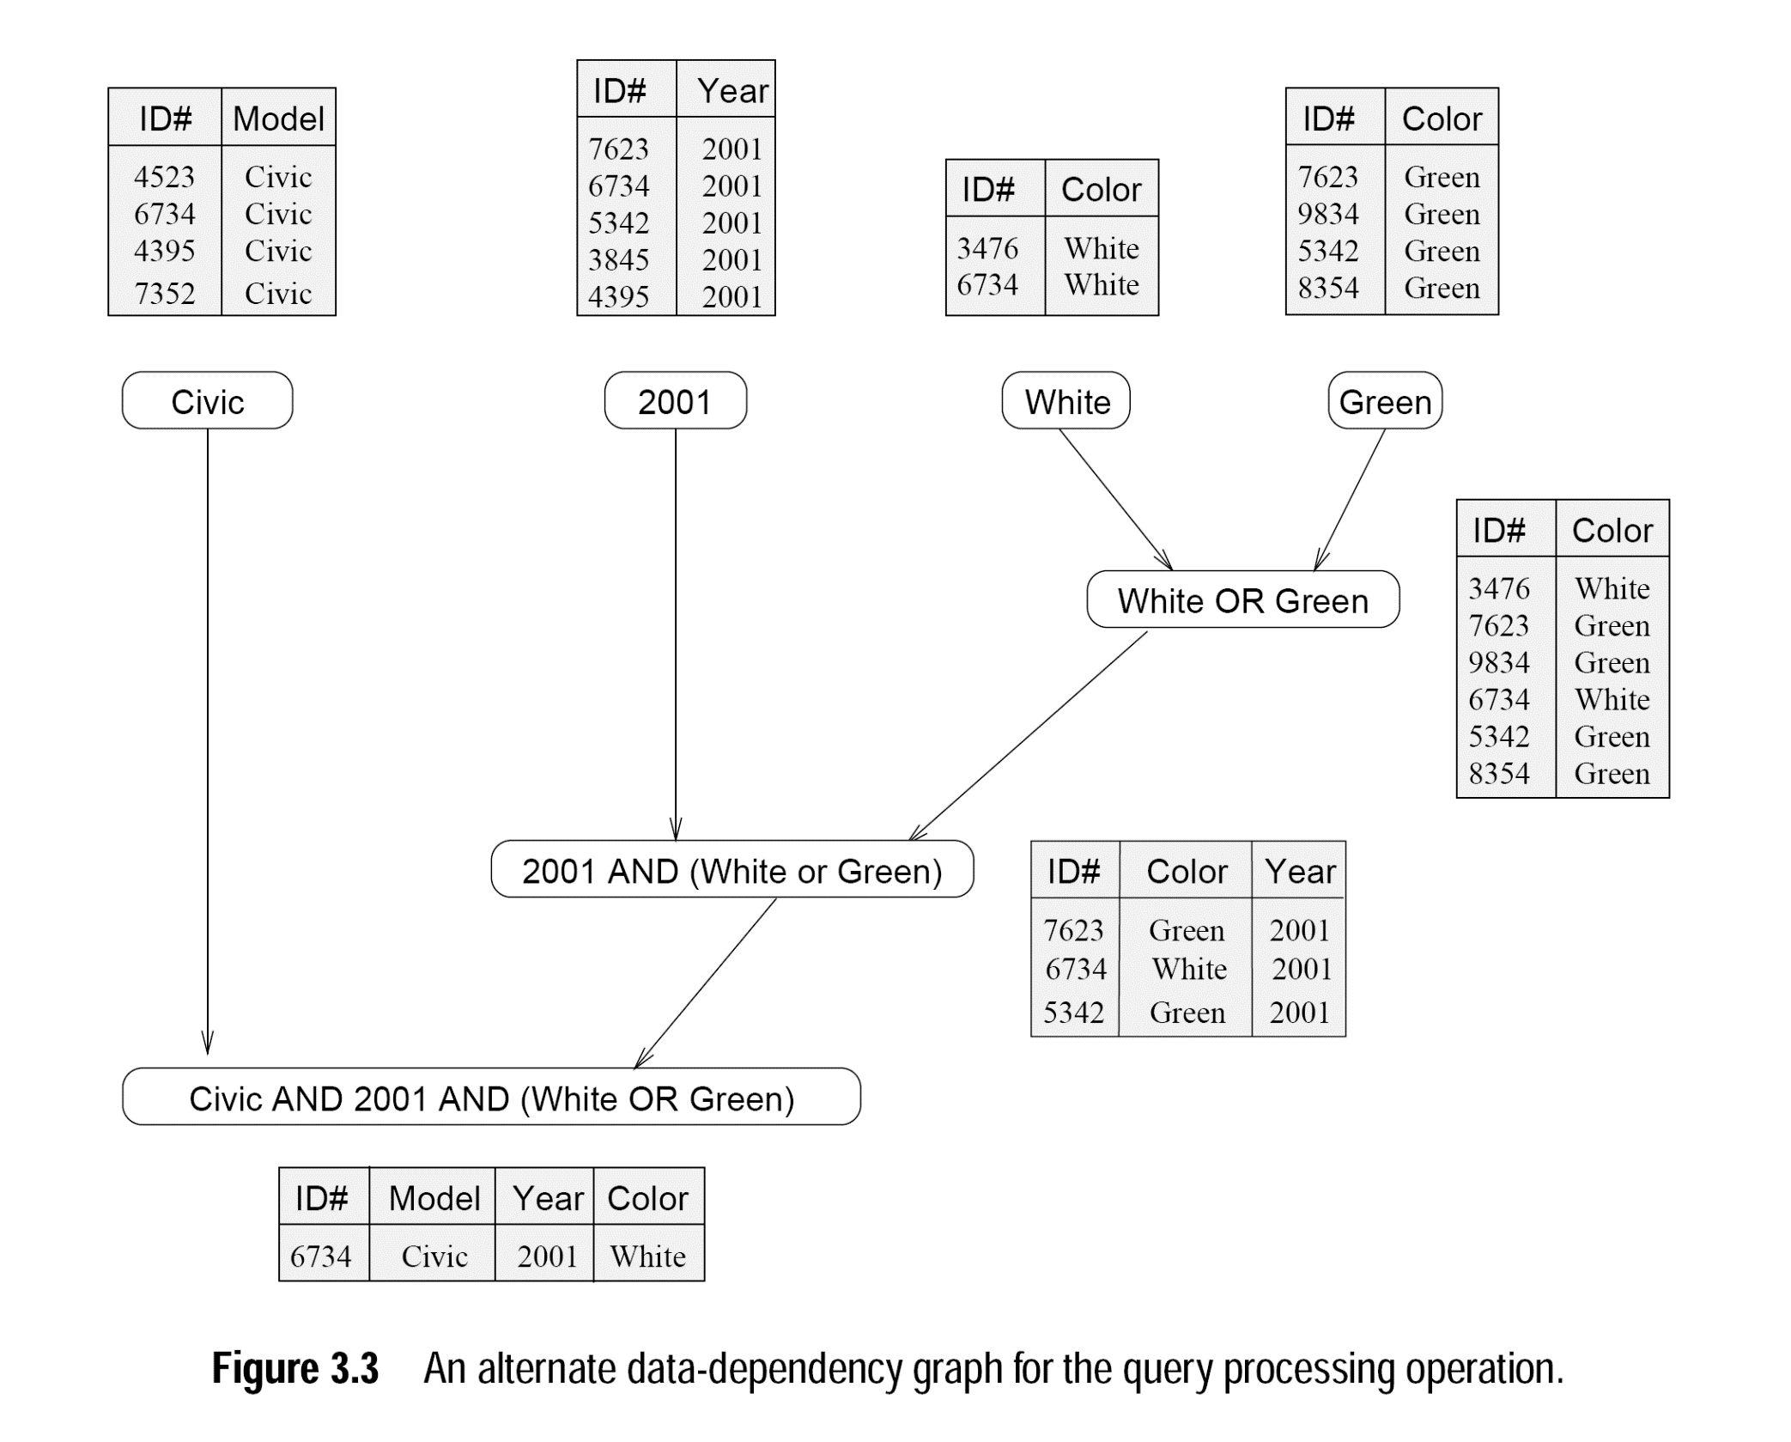

Slide 14
Principles of Parallel Algorithm Design
Granularity
The number and sizes of tasks into which a problem is decomposed determines the granularity of the decomposition
A decomposition into a large number of small tasks is called fine-grained
A decomposition into a small number of large tasks is called coarse-grained
For matrix-vector multiplication Figure 3.1 would usually be considered fine-grained
Figure 3.4 shows a coarse-grained decomposition as each tasks computes n/4 of the entries of the output vector of length n
Notes:
Granularity: roughness (means consisting of small grains or particles)
Go to the previous slides for better illustration

Slide 15
principles of Parallel Algorithm Design
Maximum Degree of Concurrency
The maximum number of tasks that can be executed simultaneously in a parallel program at any given time is known as its maximum degree of concurrency
Usually, it is always less than total number of tasks due to dependencies.
E.g., max-degree of concurrency in the task-graphs of Figures 3.2 and 3.3 is 4.
Rule of thumb: For task-dependency graphs that are trees, the maximum degree of concurrency is always equal to the number of leaves in the tree
Notes:
Go to the previous slides for better illustration

Slide 16
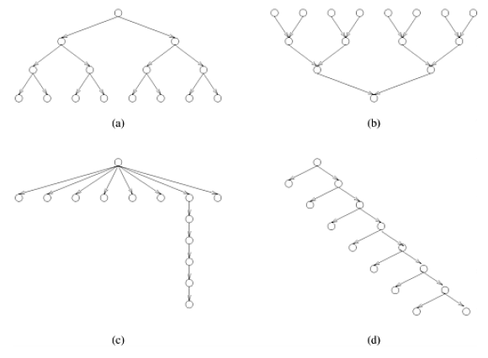
principles of Parallel Algorithm Design
Determine Maximum Degree of Concurrency?
Notes:
8

Slide 17
principles of Parallel Algorithm Design
Average Degree of Concurrency
A relatively better measure for the performance of a parallel program
The average number of tasks that can run concurrently over the entire duration of execution of the program
The ratio of the total amount of work to the critical-path length
So, what is the critical path in the graph?

Slide 18
principles of Parallel Algorithm Design
Average Degree of Concurrency
Critical Path: The longest directed path between any pair of start and finish nodes is known as the critical path.
Critical Path Length: The sum of the weights of nodes along this path
the weight of a node is the size or the amount of work associated with the corresponding task.
A shorter critical path favors a higher average-degree of concurrency.
Both, maximum and average degree of concurrency increases as tasks become smaller(finer)

Slide 19
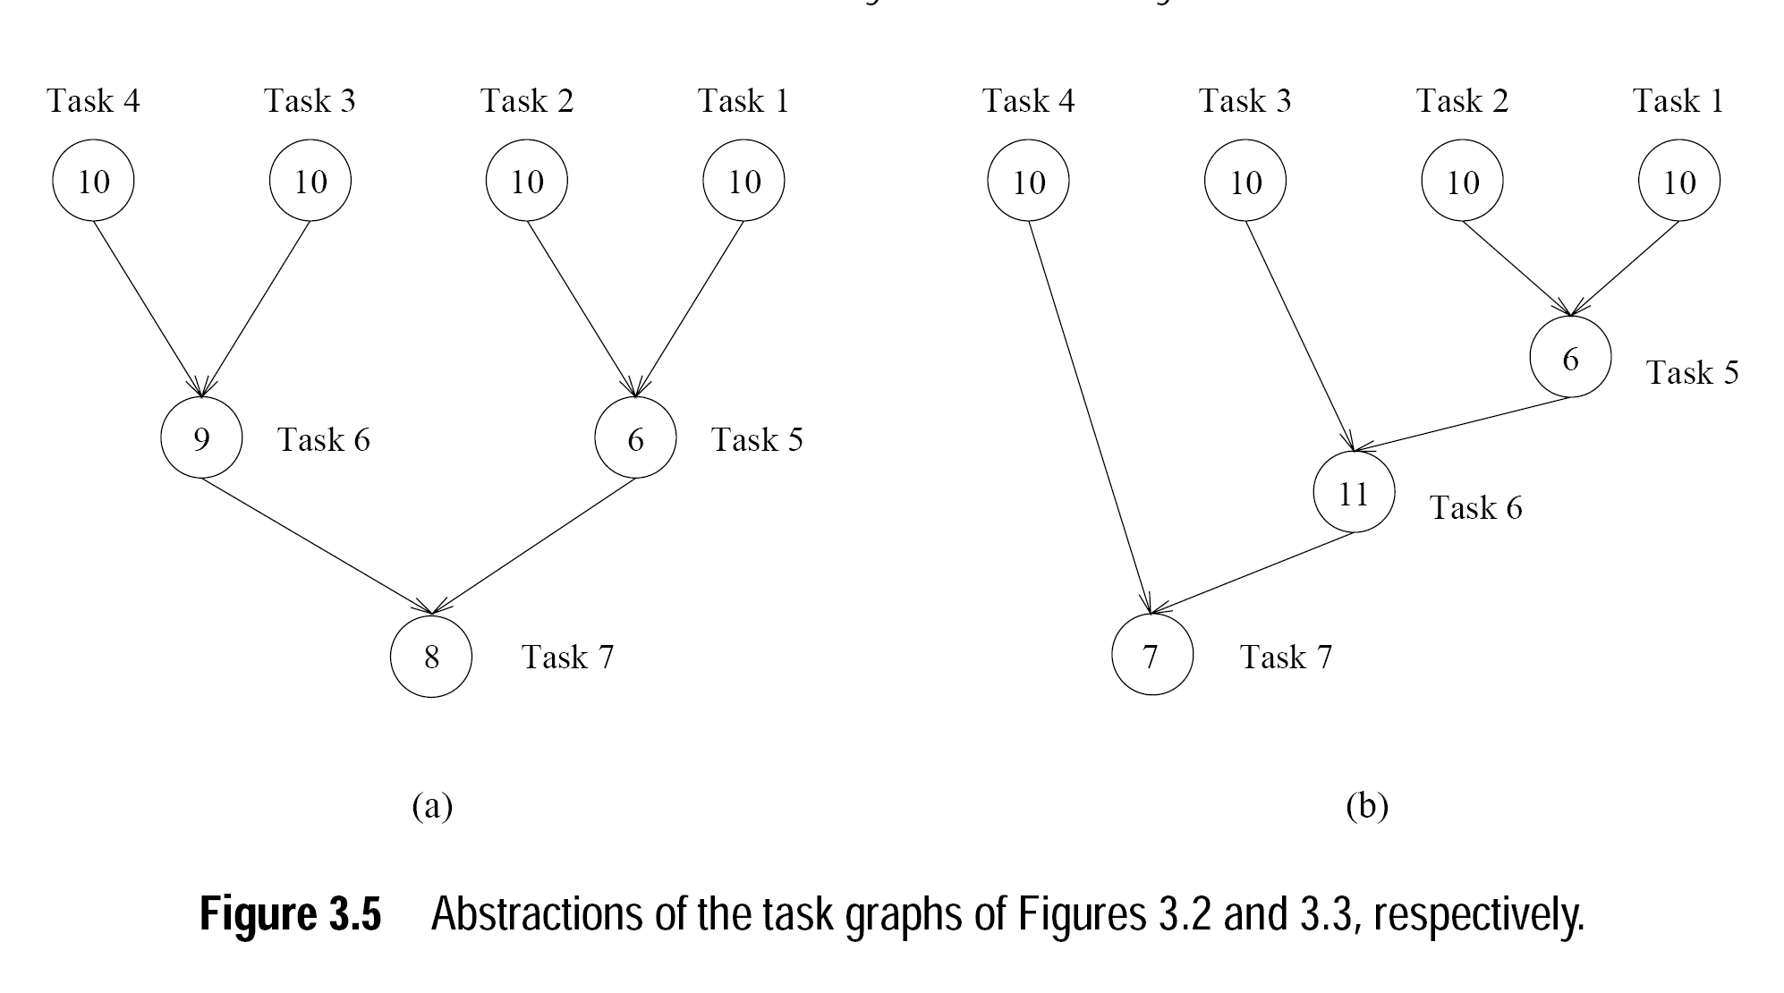
principles of Parallel Algorithm Design
Average Degree of Concurrency
Critical path lengths: 27 and 34
Total amount of work: 63 and 64
Average degree of concurrency: 2.33 and 1.88
Notes:
63/27. Although max degree of concurrency is same (40 in both cases), average degree is different. So, shape of graph also effects degree of concurrency

Slide 20
principles of Parallel Algorithm Design
Determine critical path length and average-concurrency?
Notes:
Critical path length=sum of weights along critical path= 4,4,7,8
Average concurrency= 15/4,15/4, 2, 15/8

Slide 21
principles of Parallel Algorithm Design
Task Interact Graph
Depicts pattern of interaction between the tasks
Dependency graphs only show that how output of first task becomes input to the next level task.
But how the tasks interact with each other to access distributed data is only depicted by task interaction graphs
The nodes in a task-interaction graph represent tasks
The edges connect tasks that interact with each other
Notes:
For example, in dense matrix-vector diagram, all the tasks can be shown independent in dependency graph. Since originally there is only one copy of the vector b, tasks may have to send and receive messages for all of them to access the entire vector in the distributed-memory paradigm

Slide 22
principles of Parallel Algorithm Design
Task Interact Graph
The edges in a task interaction graph are usually undirected
but directed edges can be used to indicate the direction of flow of data, if it is unidirectional.
The edge-set of a task-interaction graph is usually a superset of the edge-set of the task-dependency graph
In database query processing example, the task-interaction graph is the same as the task-dependency graph.
Notes:
For example, all the tasks can be shown independent in dependency graph of matrix-vector multiplication. Since originally there is only one copy of the vector b, tasks may have to send and receive messages for all of them to access the entire vector in the distributed-memory paradigm

Slide 23
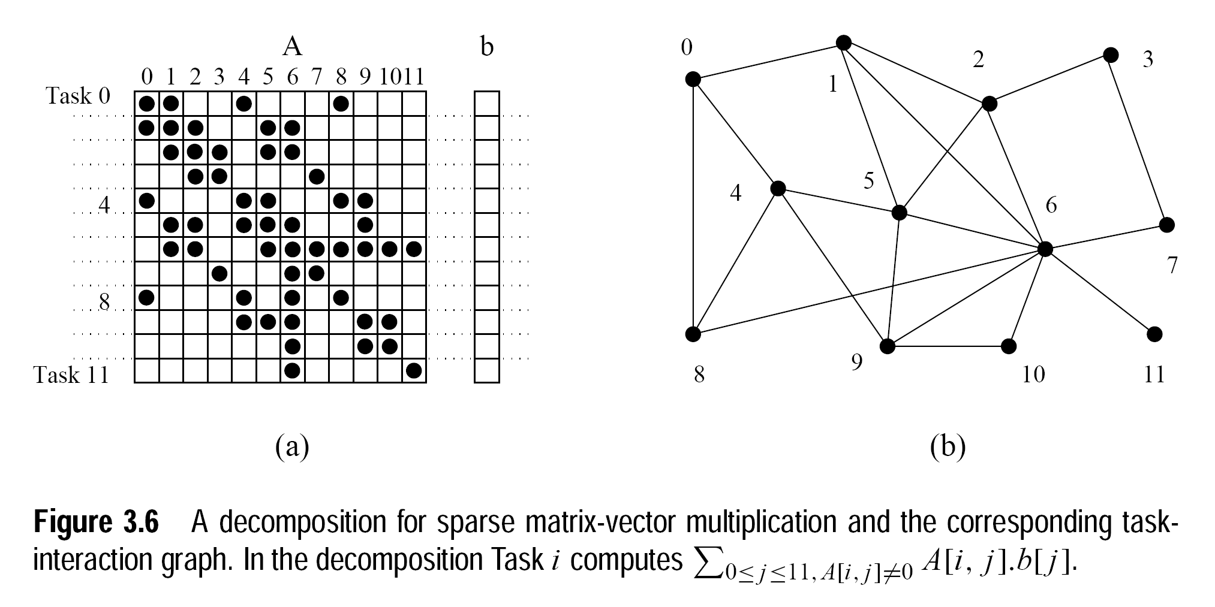
principles of Parallel Algorithm Design
Task Interact Graph (Sparse-matrix multiplication)
Notes:
Each task is assigned computation of single element of output vector y;
Furthermore, we make task(i) the owner of row A[i,*] and input vector element b[i];
In simple words:
Tasks: each task computes an entry of y[]
Assign ith row of A to Task i. Also assign b[i] to Task i.

Slide 24
principles of Parallel Algorithm Design
Processes and Mapping
Logical processing or computing agent that performs tasks is called process.
The mechanism by which tasks are assigned to processes for execution is called mapping.
Multiple tasks can be mapped on a single process
Independent task should be mapped onto different processes
Map tasks with high mutual-interactions onto a single process
Notes:
A parallel program must have several processes active and simultaneously working on different tasks to gain a significant speedup over the sequential program.

Slide 25
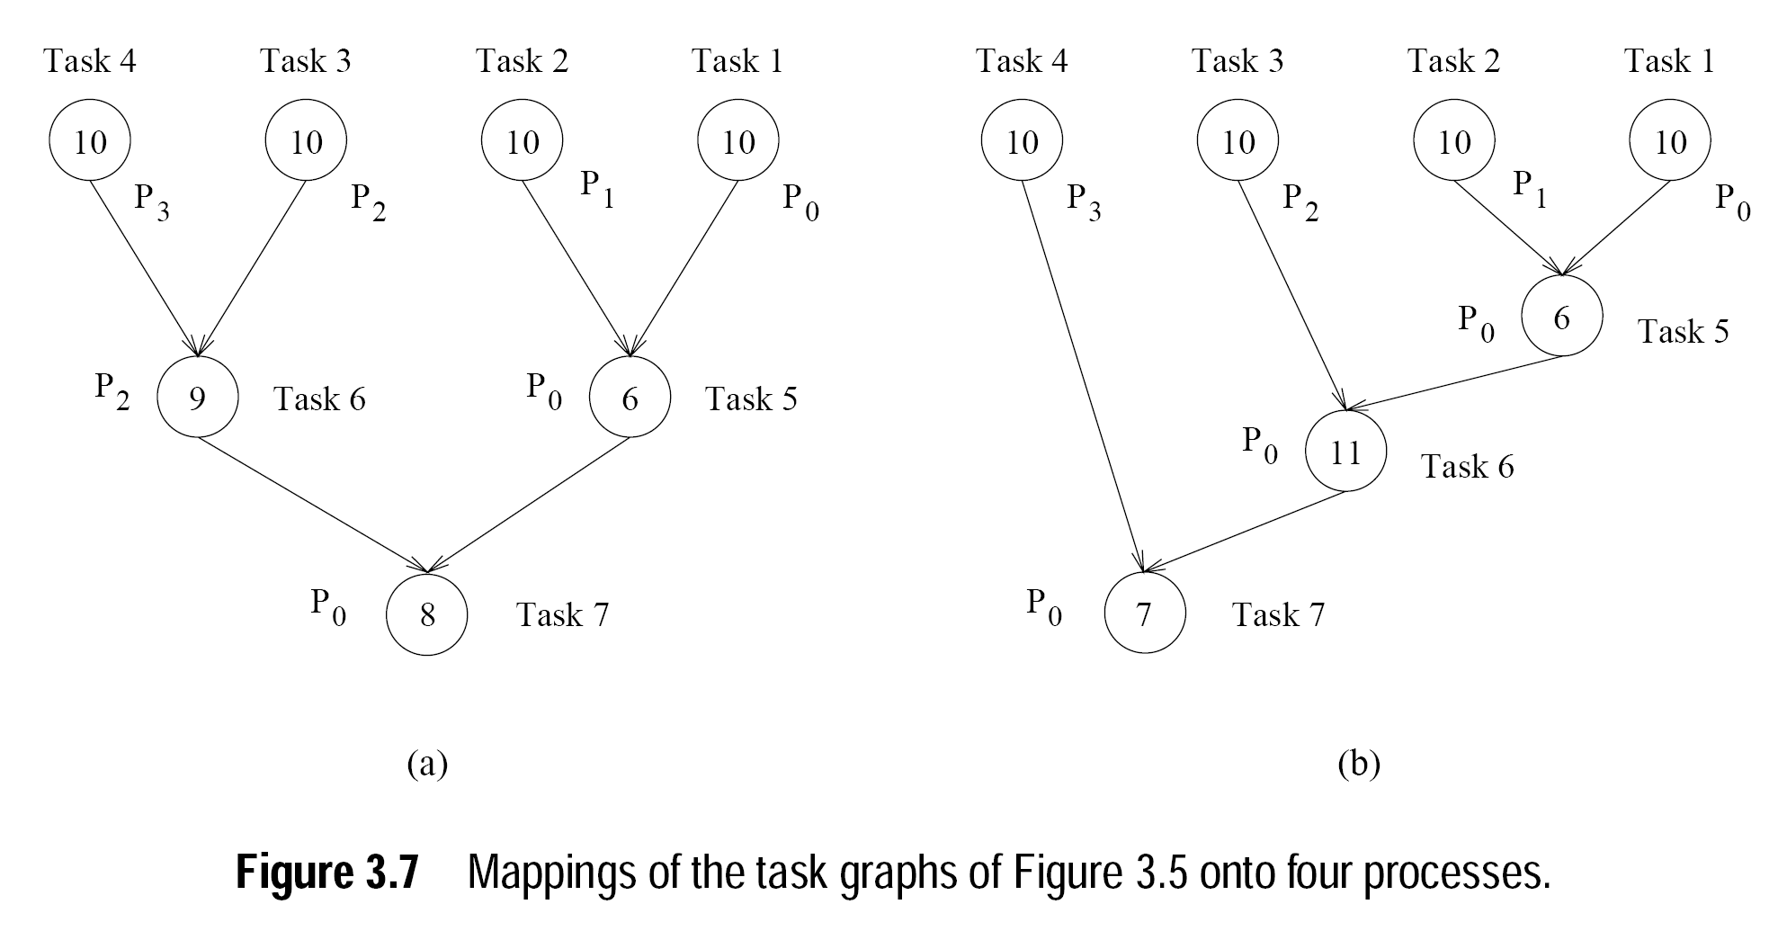
principles of Parallel Algorithm Design
Processes and Mapping
Notes:
What if in 3.7 (b), Task 5 is assigned to P2?

Slide 26
principles of Parallel Algorithm Design
Processes and Processors
Processes are logical computing agents that perform tasks
Processors are the hardware units that physically perform computations
Depending on the problem, multiple processes can be mapped on a single processor
But, in most of the cases, there is one-to-one correspondence between processors and processes
So, we assume that there are as many processes as the number of physical CPUs on the parallel computer

Slide 27

Questions

Slide 28
References
Kumar, V., Grama, A., Gupta, A., & Karypis, G. (1994). Introduction to parallel computing (Vol. 110). Redwood City, CA: Benjamin/Cummings.
Quinn, M. J. Parallel Programming in C with MPI and OpenMP,(2003).

